Slide 1
Markov-chain Motif Generation
Sereym Baek
VIP: Robotic musicianship

Slide 2
Quick Summary
Sereym Baek
Group: Robotic Musicianship VIP
Year: 1st Year Undergraduate Student
Major: Computer Science
Group: Shimon
Summary: In this semester’s VIP, I implemented a Markov-chain implementation which reads in given musical motifs and generates new motifs. The current implementation is able to read in all the notes that have been generated and then probabilistically predict the next note using Markov smoothing. It currently generates the notes and note lengths separately but has yet to predict both concurrently for more musicality of the generated motif.

Slide 3
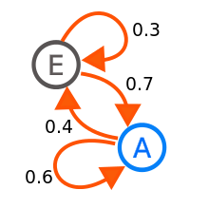
Markov chain
Given a state, what is the probability of going to different states?
States in motifs:
Notes
Note length / Time
Numerous Implementations
Note and length separate

Slide 4
technical notes
Files in MIDI (note and lengths)
Python
Mido Library
Notes and Length analyzed and generated separately

Slide 5
Implementation 1: single note
For each motif
Look at the note / time
Track of the next immediate note / time
Ex) [C, D, C, E]
Markov model: (C: [D (1) , E (1)], D[C (1)])
Generation:
Randomly create a note
Create a next note based on a probability
Ex) if first note is C, 50% chance of D and 50% chance of E

Slide 6
Result - single note implementation
Sounded random
Unlike any other given motifs
Large range
Sudden change of multiple octaves

Slide 7
Implementation 2: variable length
Treat multiple notes as a single state
Length is varied from 1 to n-1
Ex) [C, D, C, E]
Length 1 - [C: D (1) E (1), D: C (1)] – single note implementation
Length 2 - [CD: C (1), DC: E (1)]
Length 3 - [CDC: E (1) ]
Generation
Given current chain of notes, longest previously observed state
[C, C, C, D, C]
CCCDC → CCDC → CDC (found!)
Generate based on state CDC

Slide 8
Result – variable length implementation
Note:
Always generate off of the longest observed state
Very similar to given motifs
High probability that generation will just follow an observed motif
Implementation working as it should be
Example:
https://youtu.be/xlrtGJnv0Sg
Hanoi’s Motif in comparison:
https://youtu.be/QVrui6ht4Jk

Slide 9
Implementation 3: smoothing
Distribute the probability of different lengths states
Previously: (Variable Length Implementation) Afterwards:
Probability
Probability
Length
Length

Slide 10
Implementation 3: smoothing
Ex)
[C, C, C, D, C]
CCCDC → CCDC → CDC (found!) → DC (found!) →C (found!)
Out of the three found states, probabilistically choose the state for generation
CDC (weight of 3 ➔ 50%), DC (weight of 2 ➔ 33%), C (weight of 1 ➔ 17%)
Follow the variable length implementation afterwards

Slide 11
Different weighing
Linear: Exponential:
Logarithmic:
Probability
Probability
Length
Length
Probability
Length

Slide 12
result – smoothing implementation
Linear
Beginning: similar to motifs
End: random
Linear implementation examples:
https://youtu.be/zJ8SQ3pYIoc
https://youtu.be/PliSNjgGt7w
https://youtu.be/rZzw9jyv78Y

Slide 13
Future implementations
Notes and Length together
Currently separately generated
Hidden Markov Model
Filtering
Shimon specific: don’t generate impossible notes (range, time)
Problems with more motifs
Currently 30 (Hanoi’s motifs) in order to check if working correctly
Quantization
Basic music theory (different keys)

Slide 14
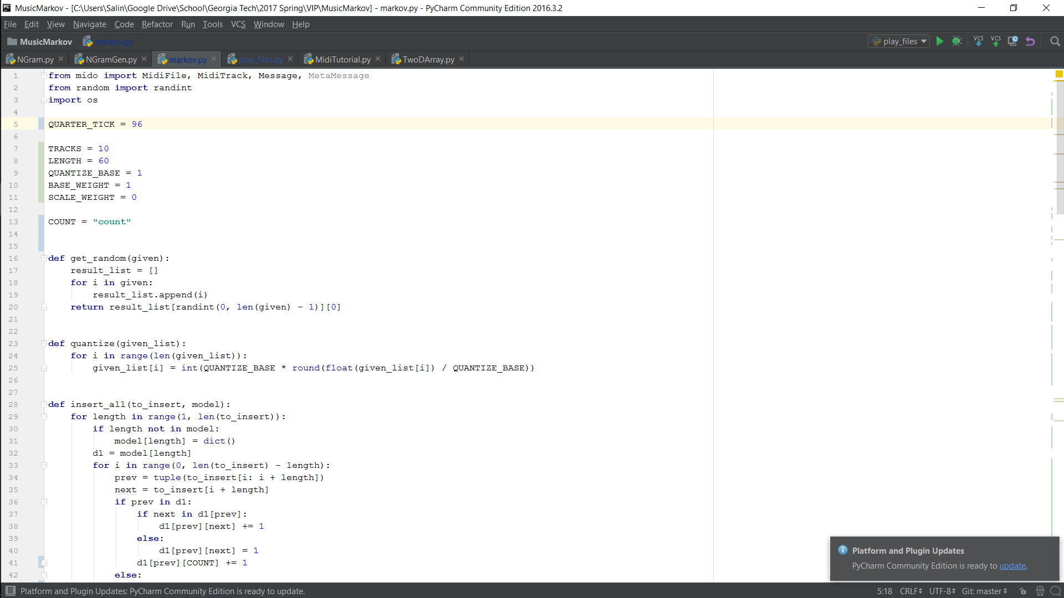

Slide 15
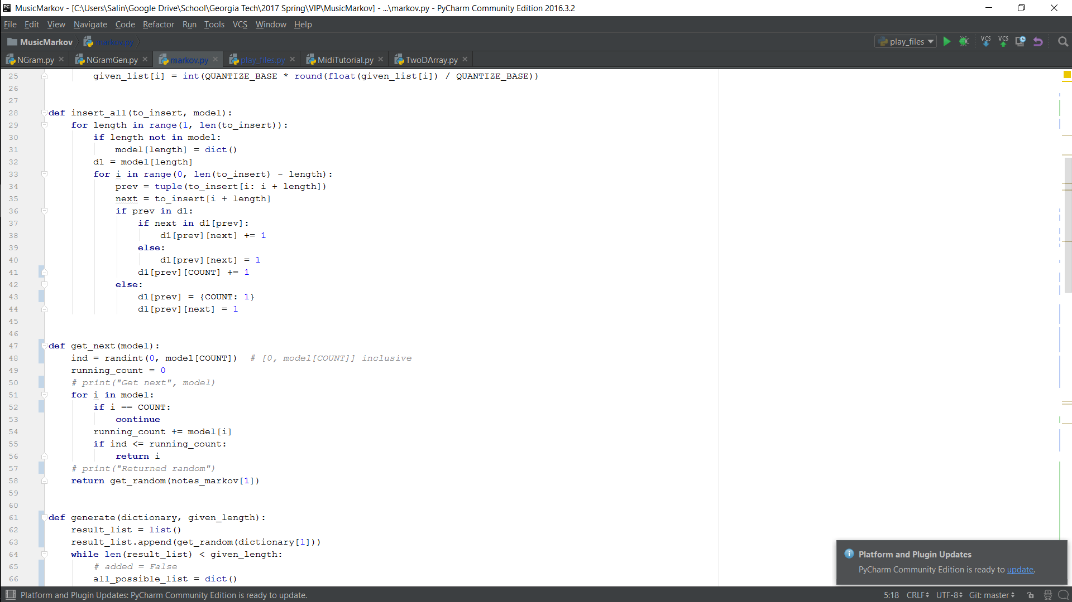

Slide 16
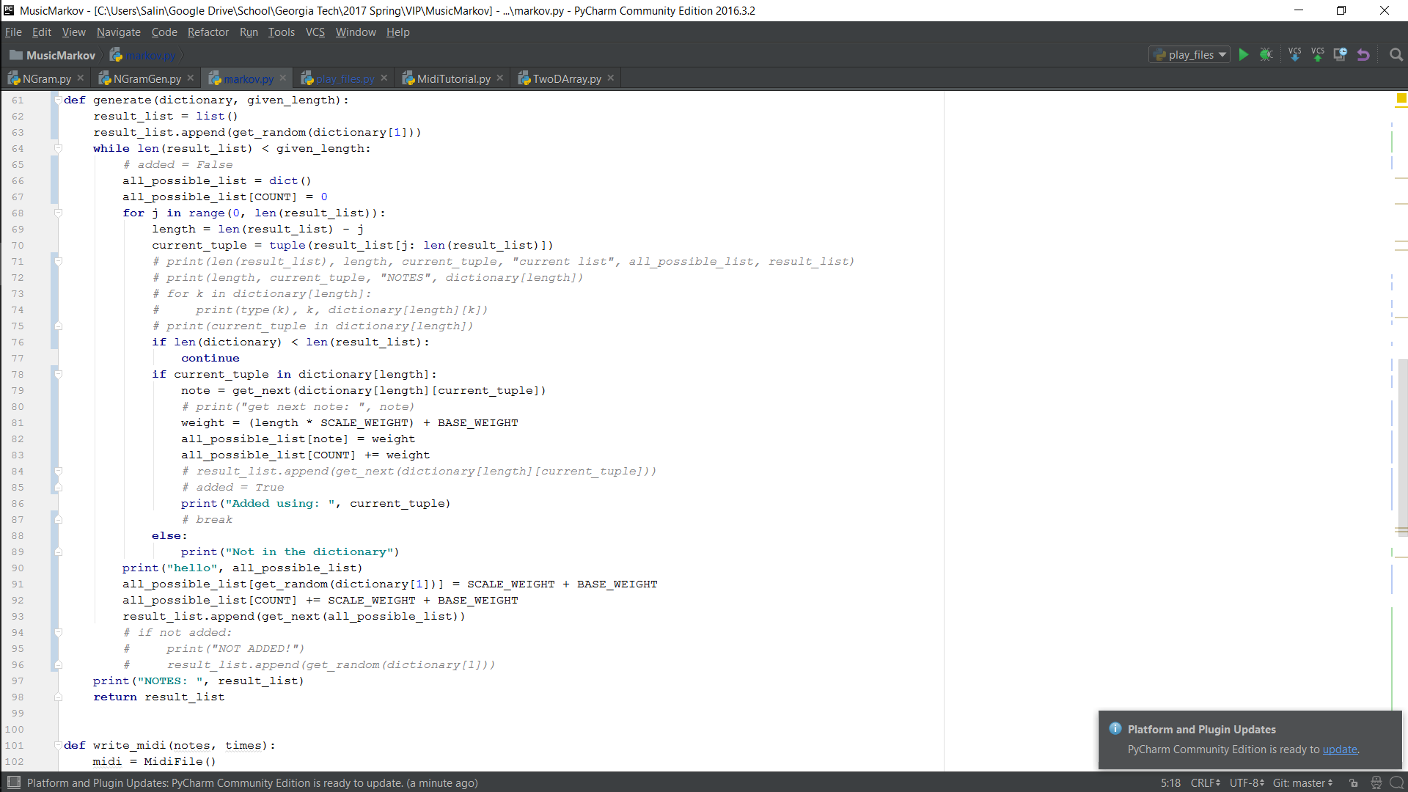

Slide 17
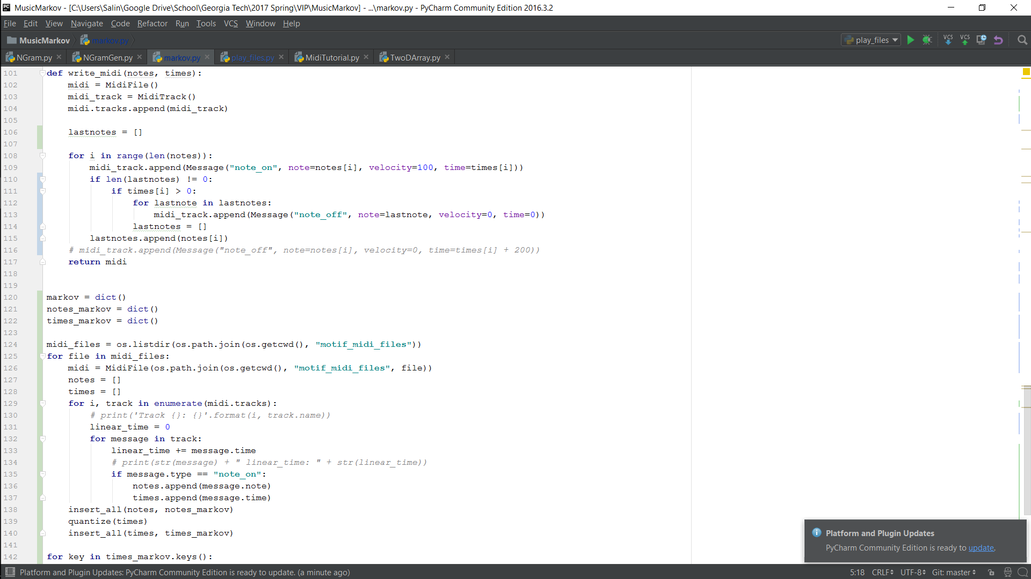

Slide 18
